Slide 1
Instance Segmentation of Cells with Cellpose
Evaluation on 50 fluorescence microscopy images
Devanshu Khadka
University of Chicago
08/29/2025

Slide 2
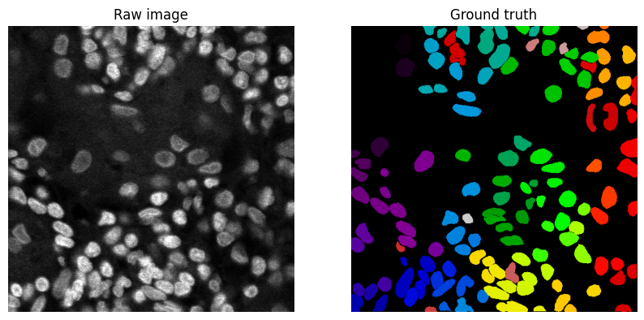
Dataset and Task Overview
Dataset given: 50 fluorescence microscopy images
Provided data: ground-truth masks (answer sheets)
Goal: automate instance segmentation and identify each cell separately.

Slide 3
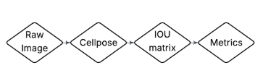
Segmentation Pipeline In Steps
Normalize all fluorescence images to the range of 0 to 1 to ensure stable input
Run default Cellpose pre trained model on each image which gives a instance label mask where each nucleus is assigned a unique id \
Compare predicted masks to ground truth using Intersection over Union(IoU)

Slide 4
Evaluation Metrics
Precision = True Positive / (True Positive + False Positives)
Precision measures how many predicted cells were correct.
Recall = True Positive / (True Positive + False Negatives)
Recall measures how may real cells were detected.
F1 Score = 2 × (Precision × Recall) / (Precision + Recall)
F1 score is the harmonic mean between Recall and Precision.
Dice = 2|A∩B| / (|A|+|B|)
The Dice score offers a quantitative and objective measure of how well a model's segmentation matches the true segmentation.

Slide 5
Results
Metric | Value | Interpretation
Precision | 0.824 | 82% of predicted nuclei matched real nuclei (some false positives remain).
Recall | 0.886 | 89% of real nuclei were detected (few misses).
F1-score | 0.846 | Balanced performance across precision and recall.
Dice score | 0.876 | Strong pixel-level overlap between predicted and ground-truth nuclei.

Slide 6
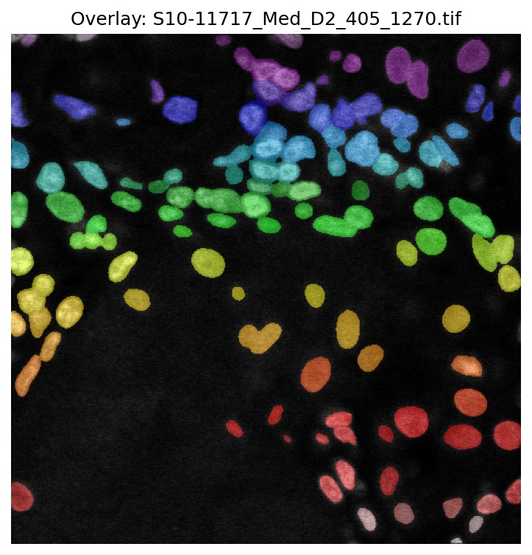

Qualitative Results: Overlays
Precision: 0.86
Recall: 0.90
F1: 0.88
Dice: 0.86
This is a good performance example: all metrics are above dataset averages. Masks are close to ground truth with few misses/false alarms.
Predicted Overlay
Ground Truth

Slide 7
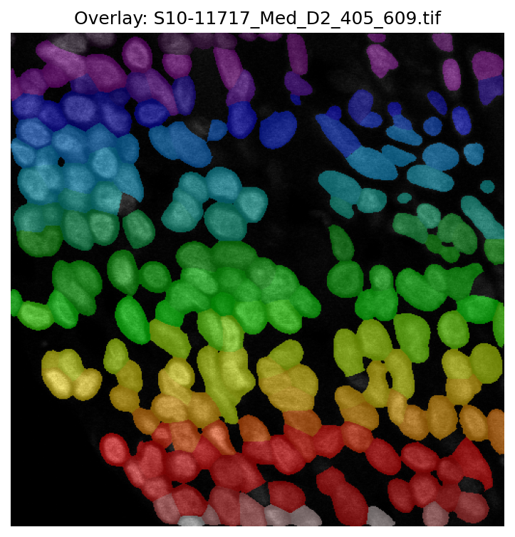
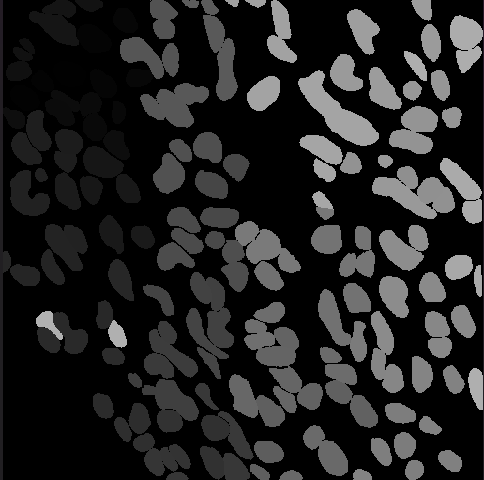
Qualitative Results: Overlays 2
Precision: 0.71 (low)
Recall: 0.82
F1: 0.76
Dice: 0.79
This is a poor performance example: Precision is much lower than average (0.82 overall). Likely too many false positives or merges.
Predicted Overlay
Ground Truth

Slide 8
Limitations
Model choice: Default/general Cellpose model used, not the nuclei-specific pre-trained weights. Performance may improve with the correct model.
No fine-tuning: Cellpose was not retrained on this dataset, so precision in crowded or faint regions may be suboptimal.
Dataset size: Only 50 images, which limits the statistical depth of the evaluation.

Slide 9
References
SquidPy. (n.d.). Nuclei segmentation using cellpose. Nuclei segmentation using Cellpose - squidpy documentation. https://squidpy.readthedocs.io/en/stable/notebooks/tutorials/tutorial_cellpose_segmentation.html
Ibm. (2025, July 22). What is image segmentation?. IBM.https://www.ibm.com/think/topics/image-segmentation
VTlabs. (n.d.). Intersection over union (IOU): Definition, calculation, code. V7. https://www.v7labs.com/blog/intersection-over-union-guide’

Slide 10
Thank you!
Devanshu Khadka
devanshu@uchicago.edu

